Slide 1
Cab Service

Slide 2
This project present in git repository in below URL
https://github.com/Kaleakash/e-learning-app.git
Plz login to virtual lab and clone this project in virtual lab using command as
git clone https://github.com/Kaleakash/e-learning-app.git

Slide 3
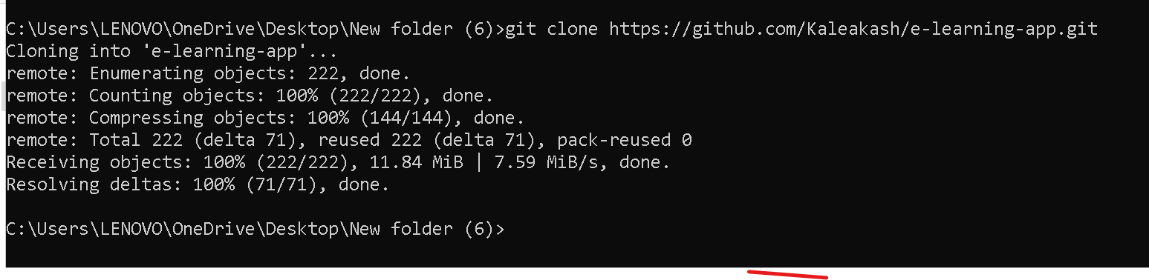

Slide 4
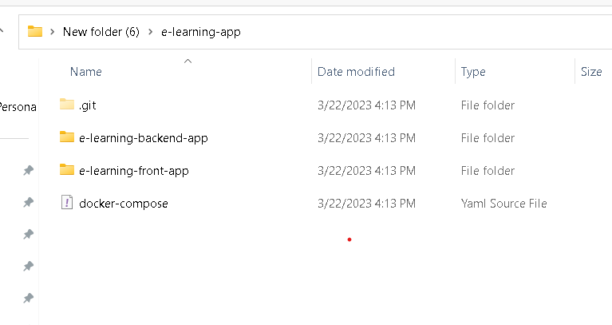
Project structure path

Slide 5
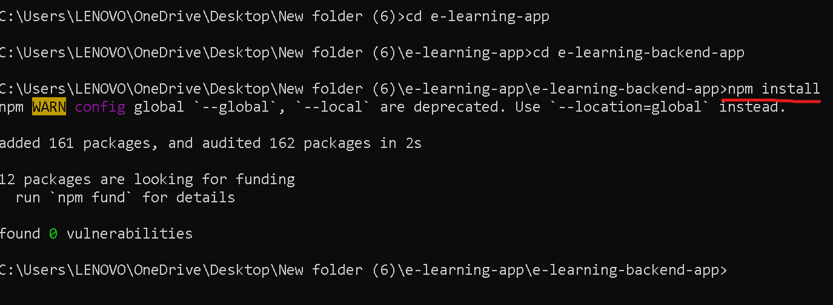
First move inside a e-learning-backend-app
Then run the command as npm install to install all required dependencies.

Slide 6
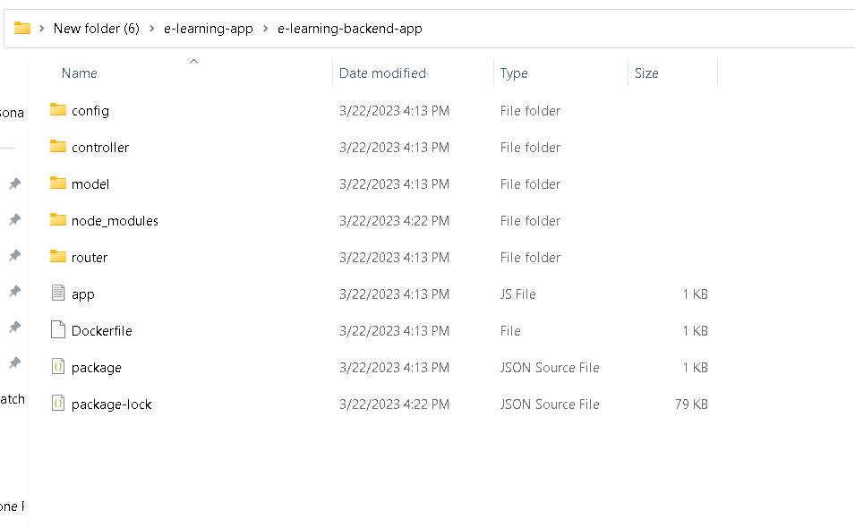
After updated you can see the structure of the project

Slide 7
Project structure explanation
Config : this folder contains database configuration details as well as initial set up for database. If we use local machine database then ip address must be local host or 127.0.0.1 with port number 27017.if we use Docker container then mongo db container name ie present in docker-compose.yml file as database.

Slide 8
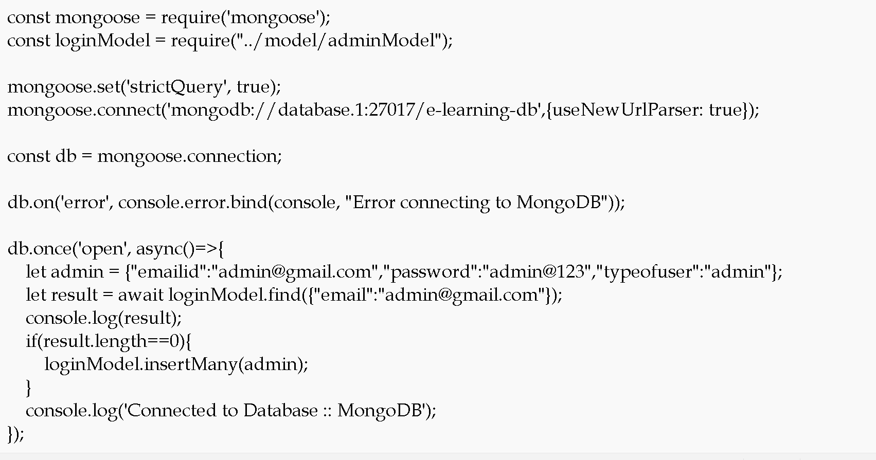

Slide 9
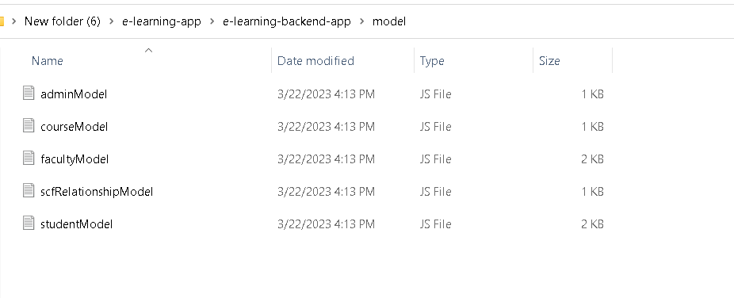
Model file: this file contains the structure of collection with schema definition

Slide 10
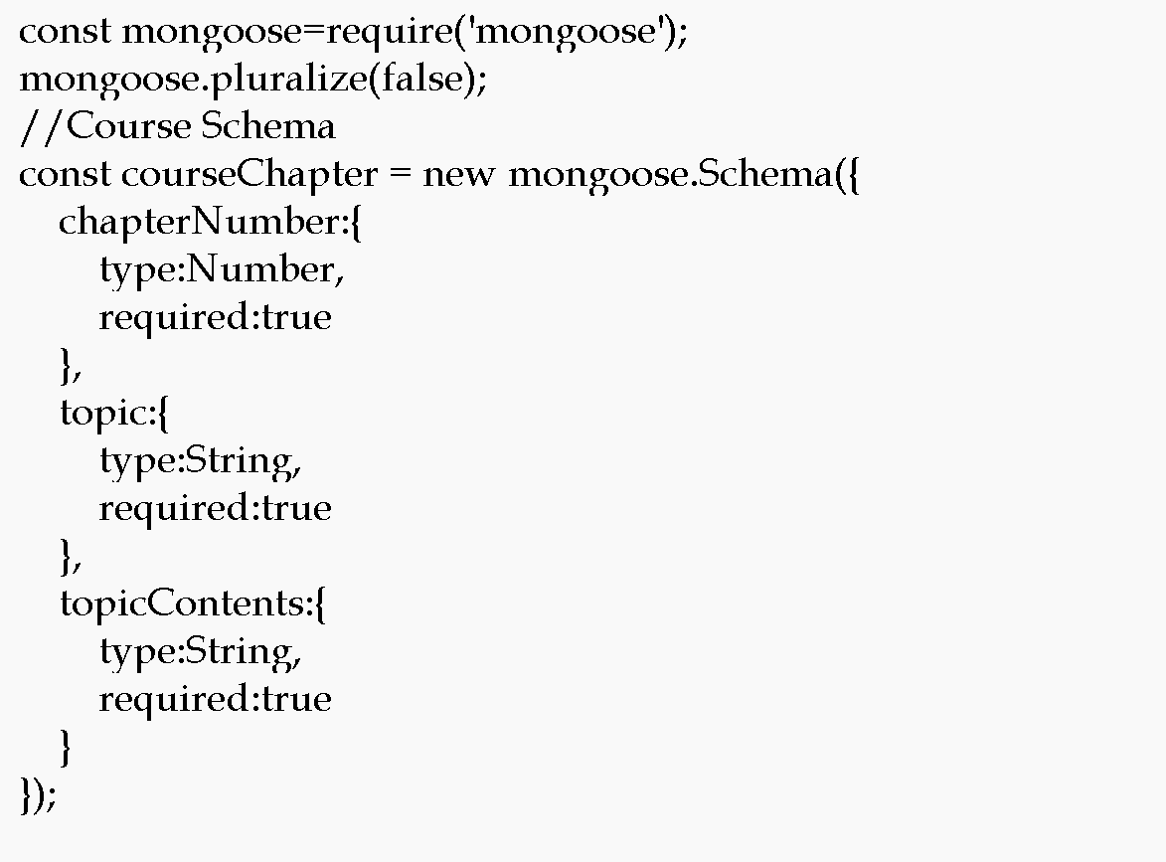

Slide 11
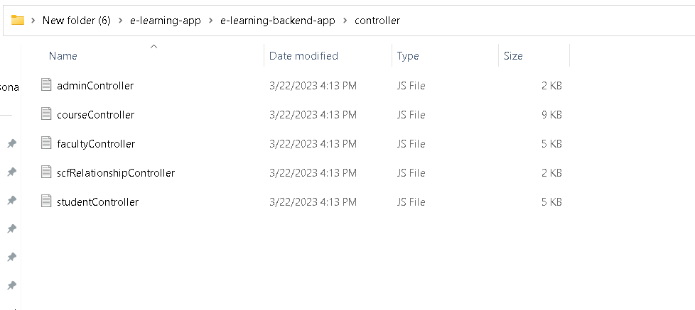
Controller file : which takes req and res and do the operation on model

Slide 12
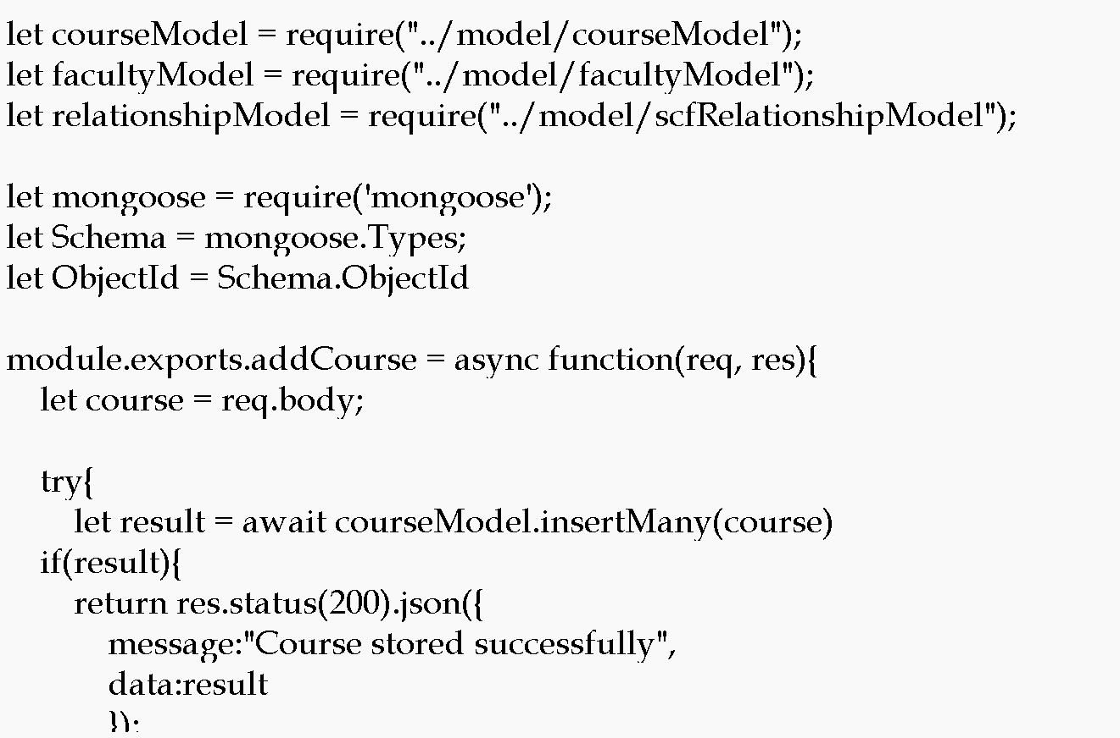

Slide 13
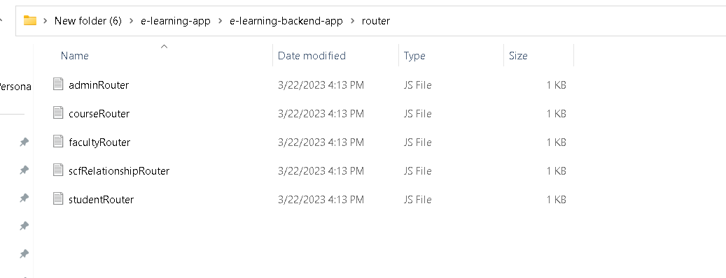
Router : it is use to map the request and http methods.

Slide 14
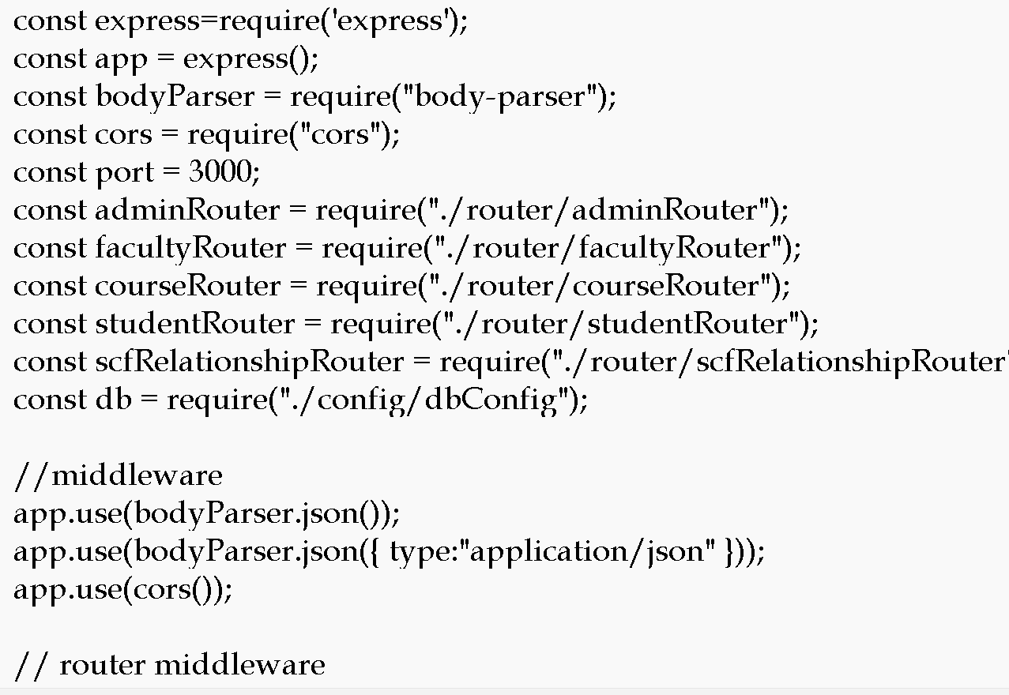
App.js : this is main file. Entry of the application

Slide 15
We will create Dockerfile
We are going to run the project using docker container so we need to create the Dockerfile.

Slide 16
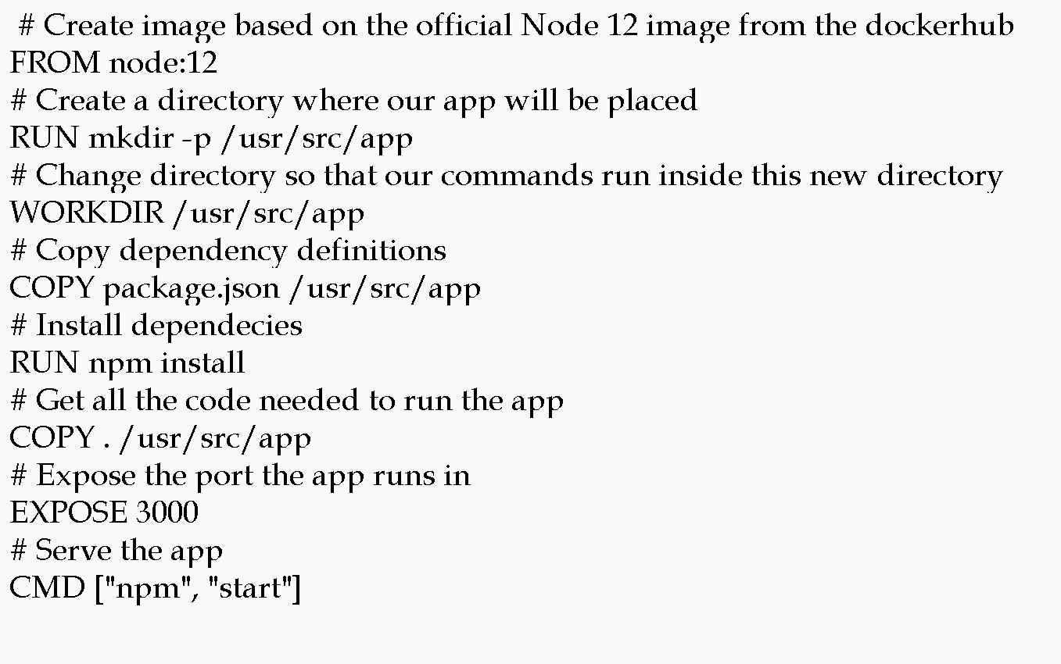

Slide 17
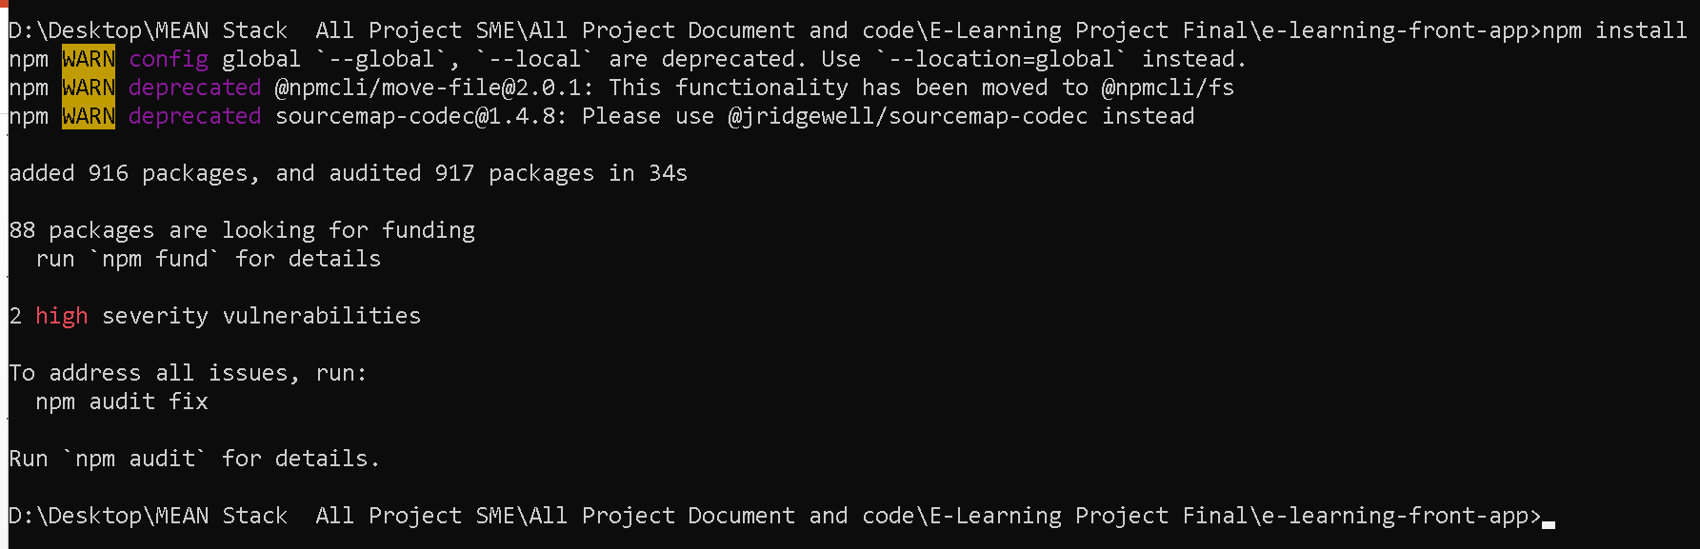
Now move inside a e-learning-front-app
Then run the command as npm install to install all required dependencies.

Slide 18
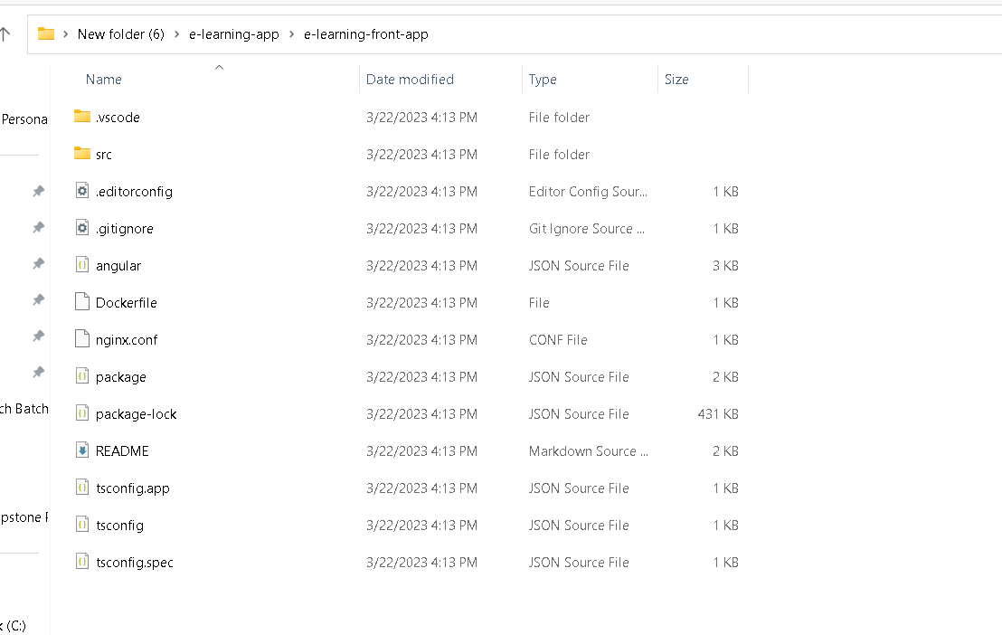
Front – angular project structure

Slide 19
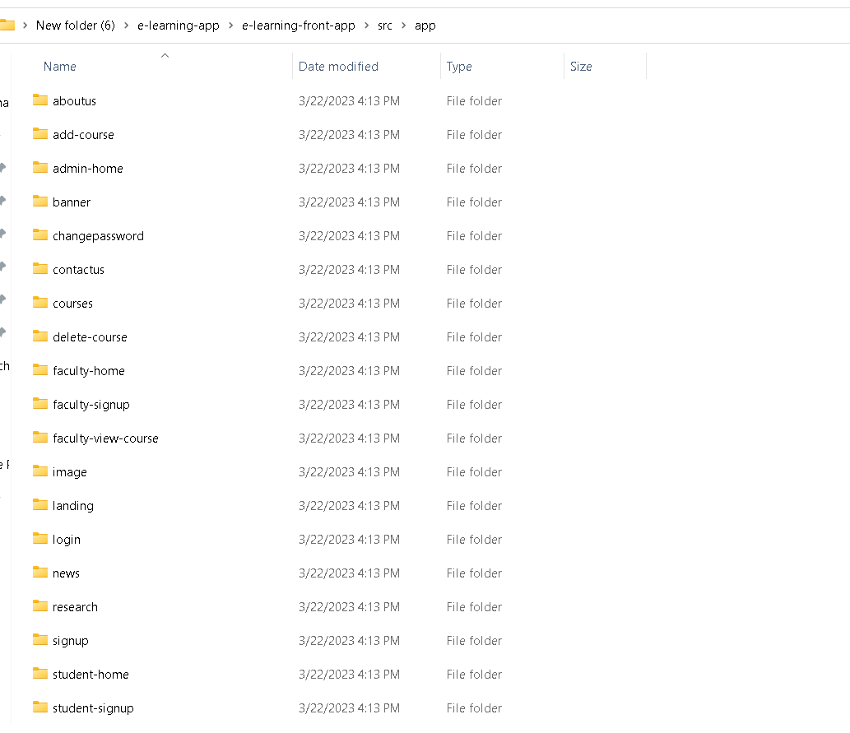
Project structure
Angular project contains lot of components, service as well as model classes .

Slide 20
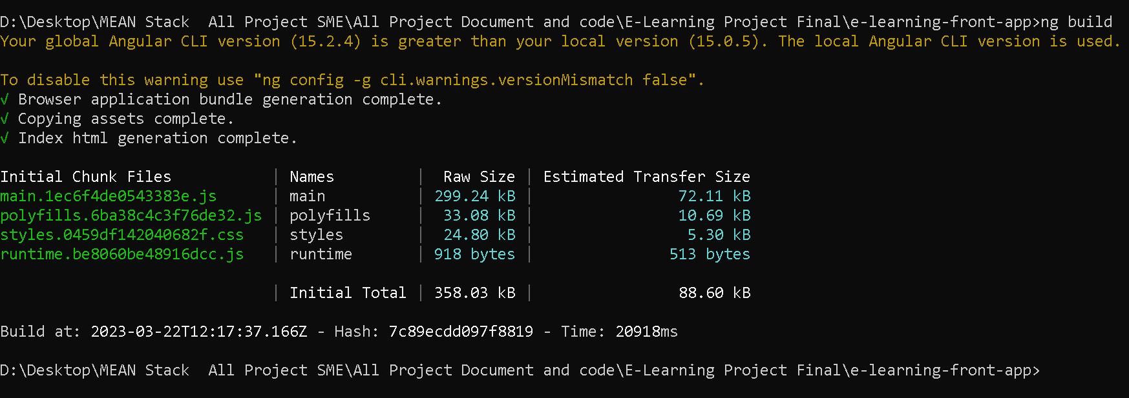
Now build the angular project using command as ng build

Slide 21
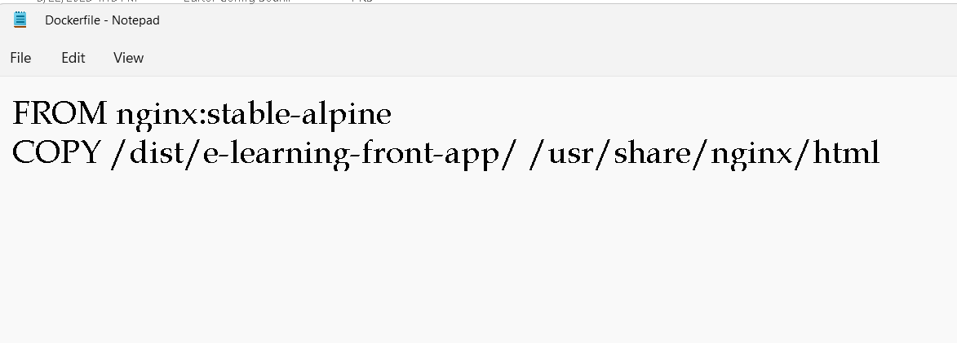
Now we will create the Dockerfile
We are going to run angular project using Dockerfile

Slide 22
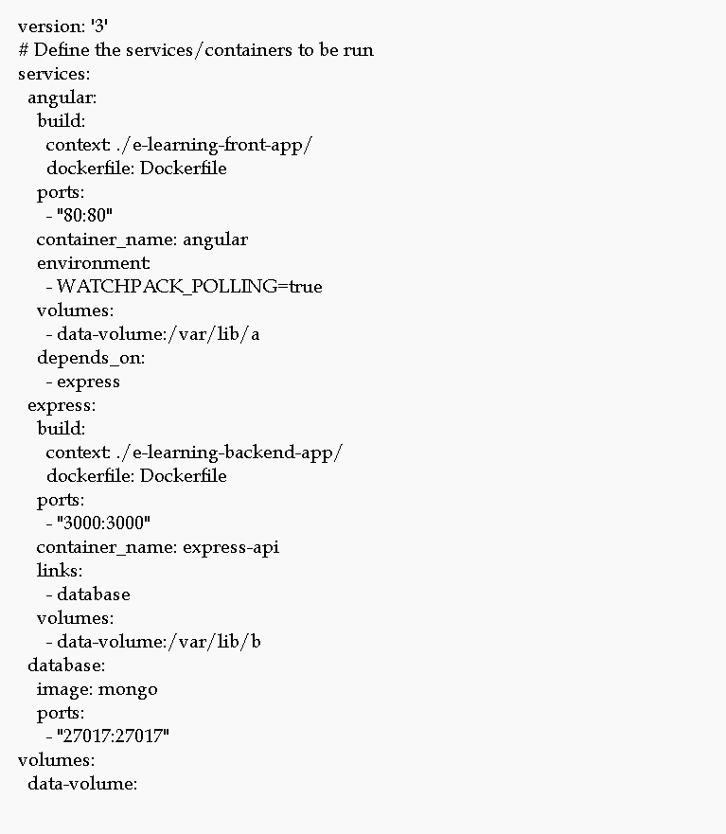
Now will create the docker-compose.yml

Slide 23
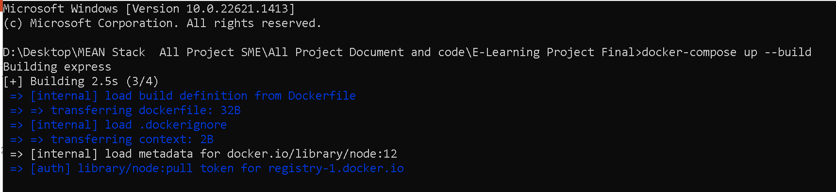
Now run the docker-compose file
docker-compose up –build

Slide 24
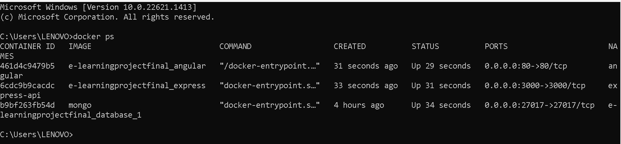
If everything go fine
Then three container get start.
Open another terminal and check the container status.

Slide 25
Container details
Angular running with nginx server with 80 port number.
Express js running on port number 3000 port number
Mongo db database running on 27017 port number.

Slide 26
Now run the application using url as
http://localhost:80

Slide 27
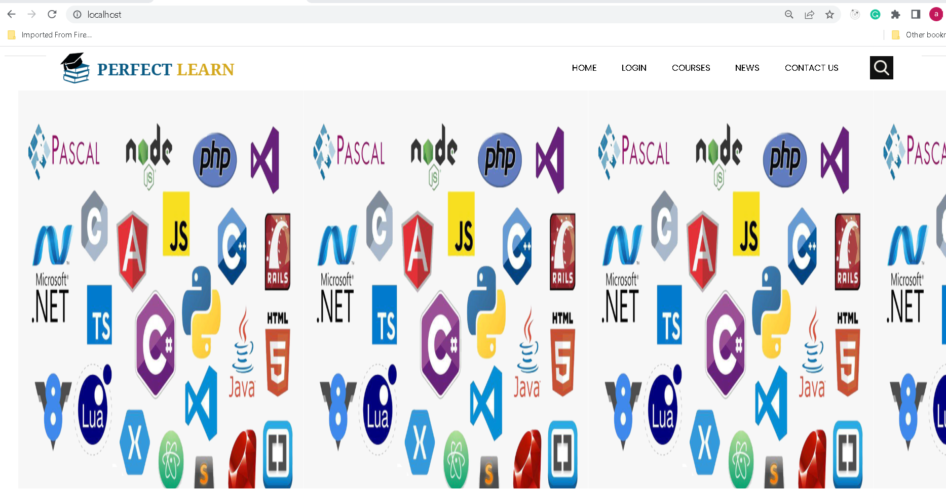

Slide 28
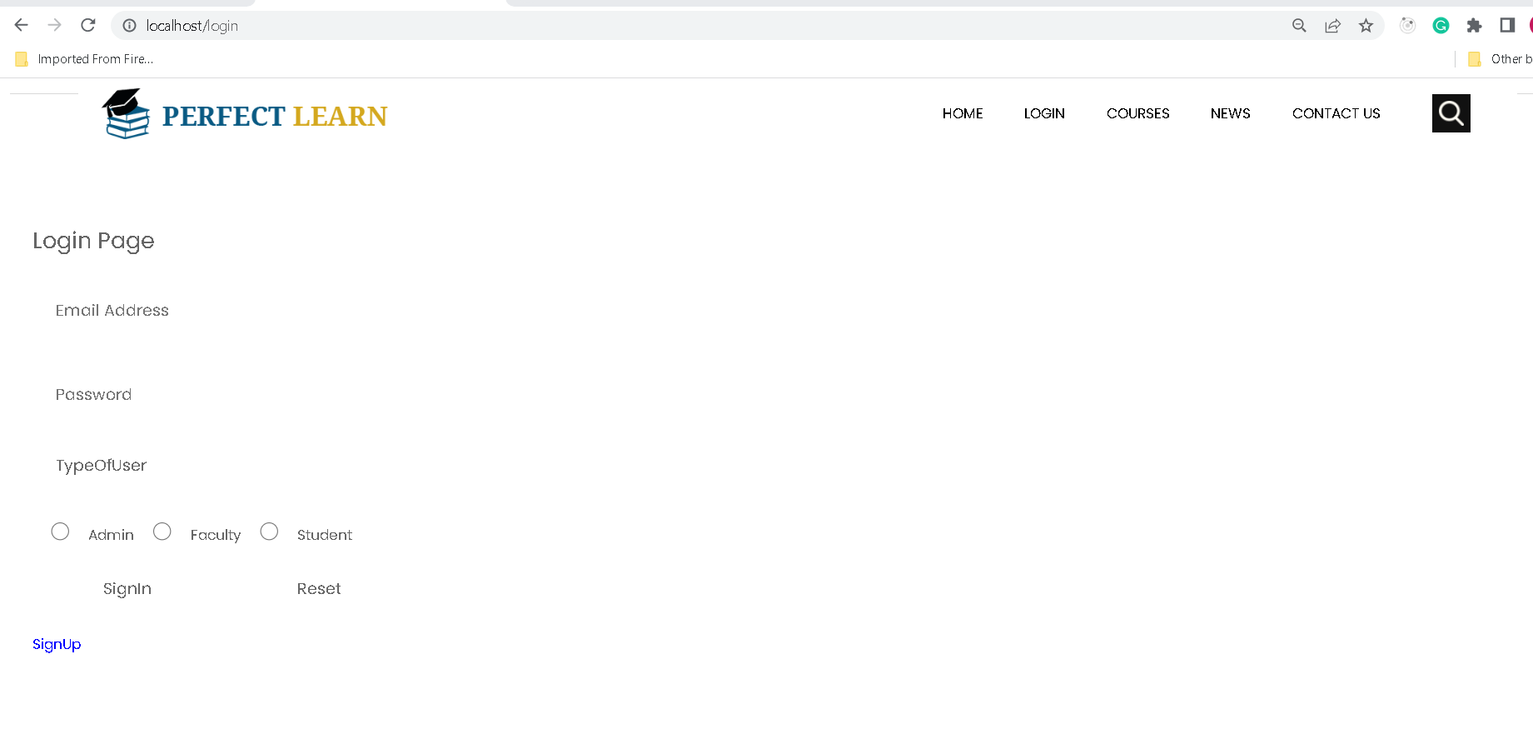
Login

Slide 29
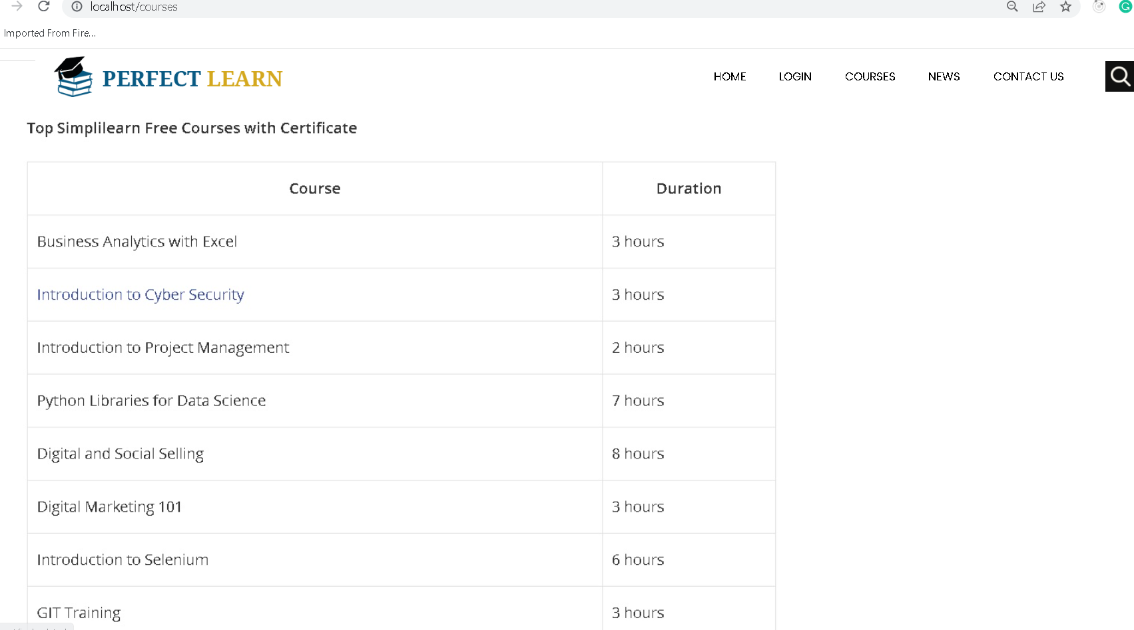
Courses

Slide 30
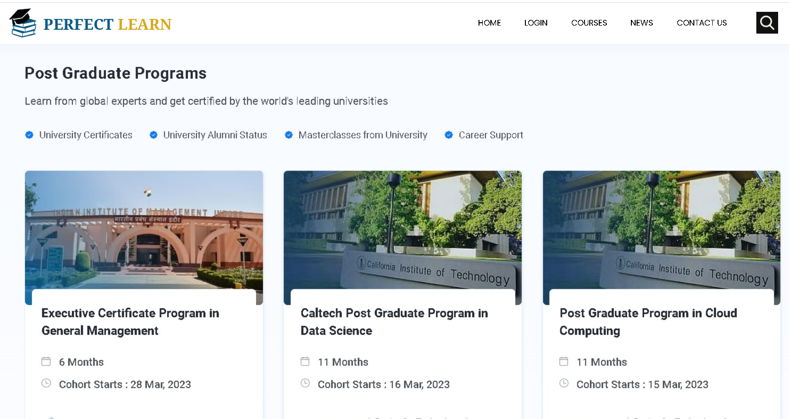
News

Slide 31
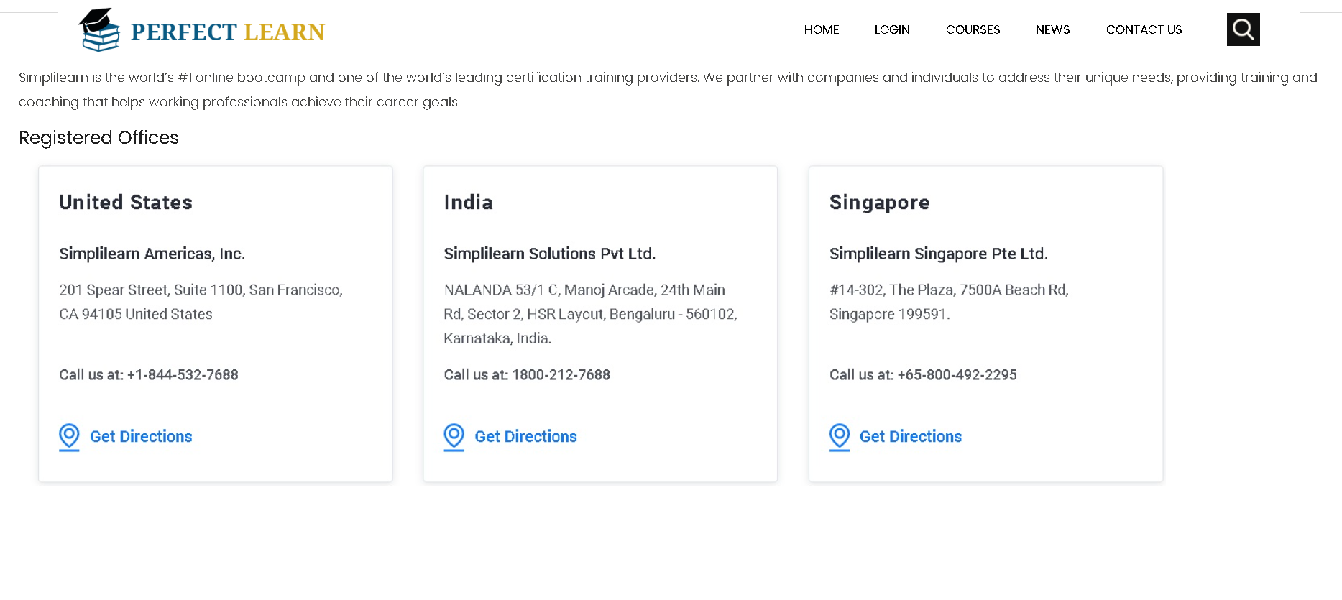
Contact us

Slide 32
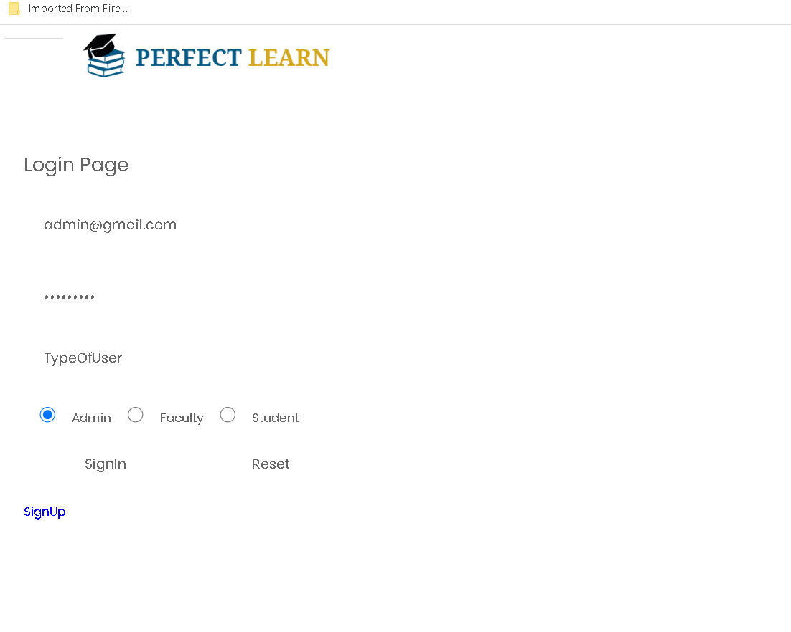
Admin login with emailid as admin@gmail.com and password as admin@123

Slide 33
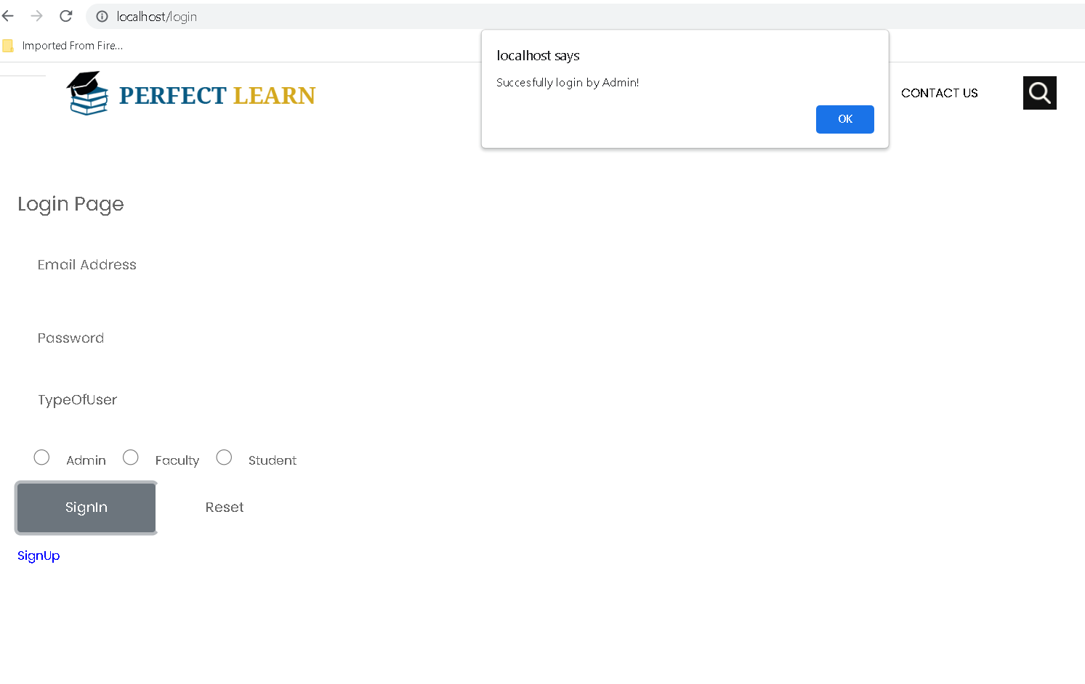
Admin successfully login

Slide 34
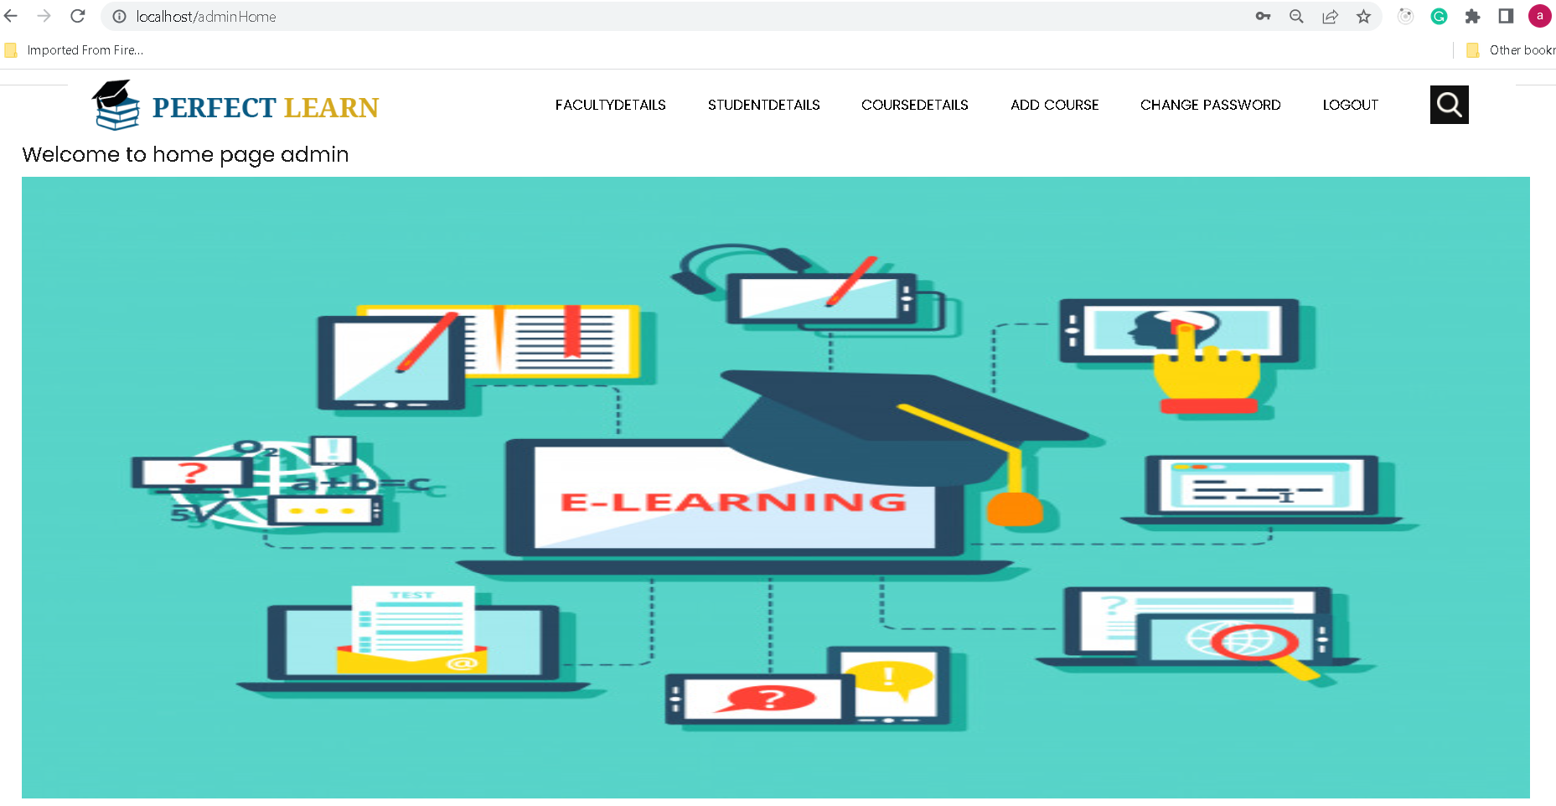
Admin home page

Slide 35
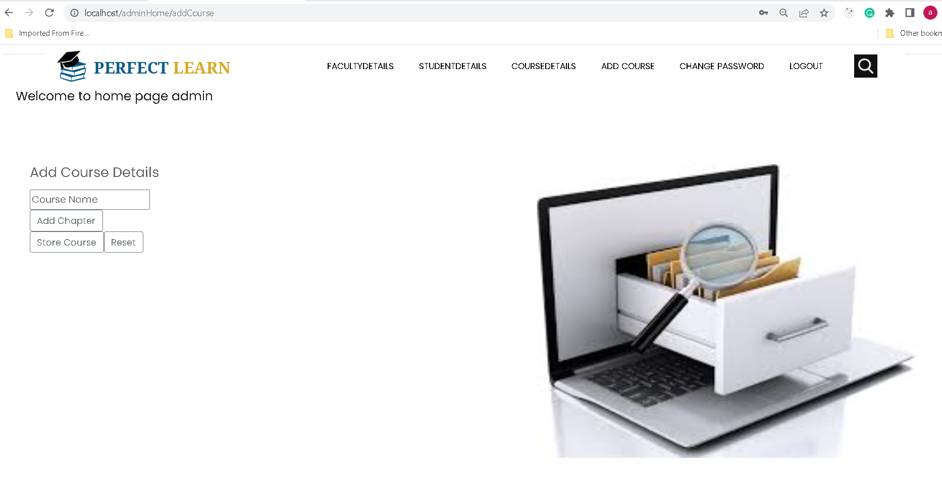
First we will add the course

Slide 36
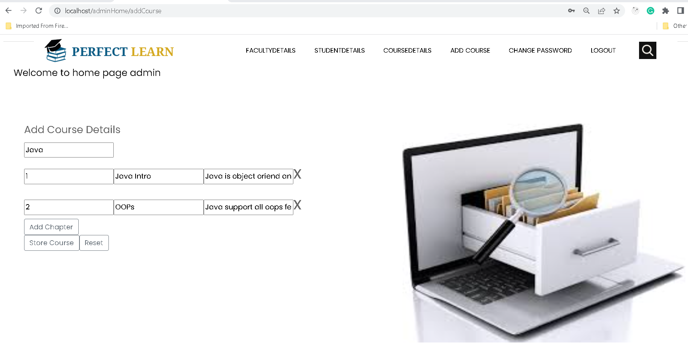
Continue…

Slide 37
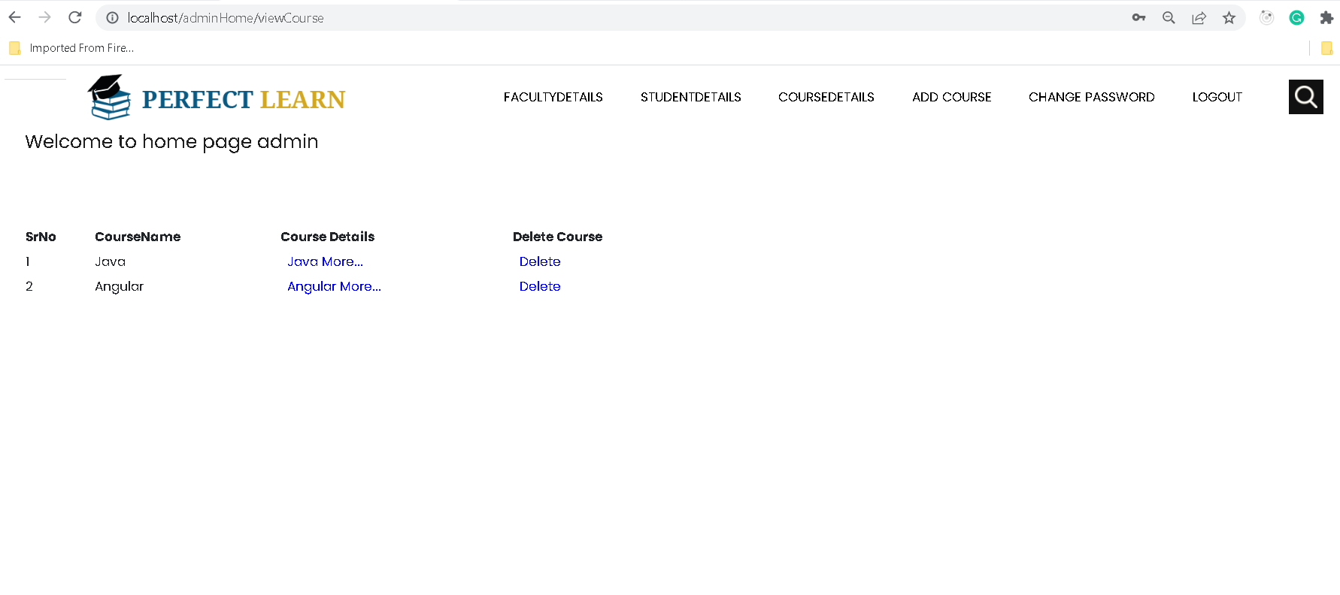
View added course and we can delete course also

Slide 38
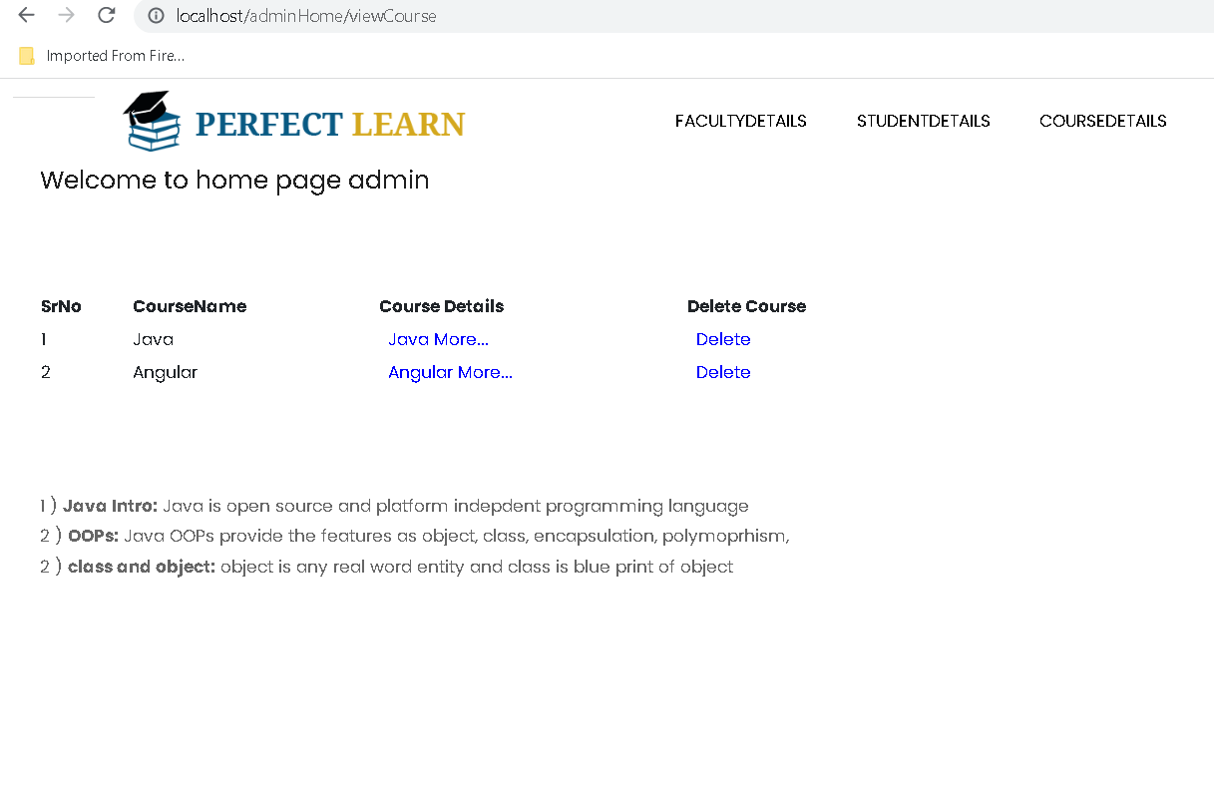
View the specific course details

Slide 39
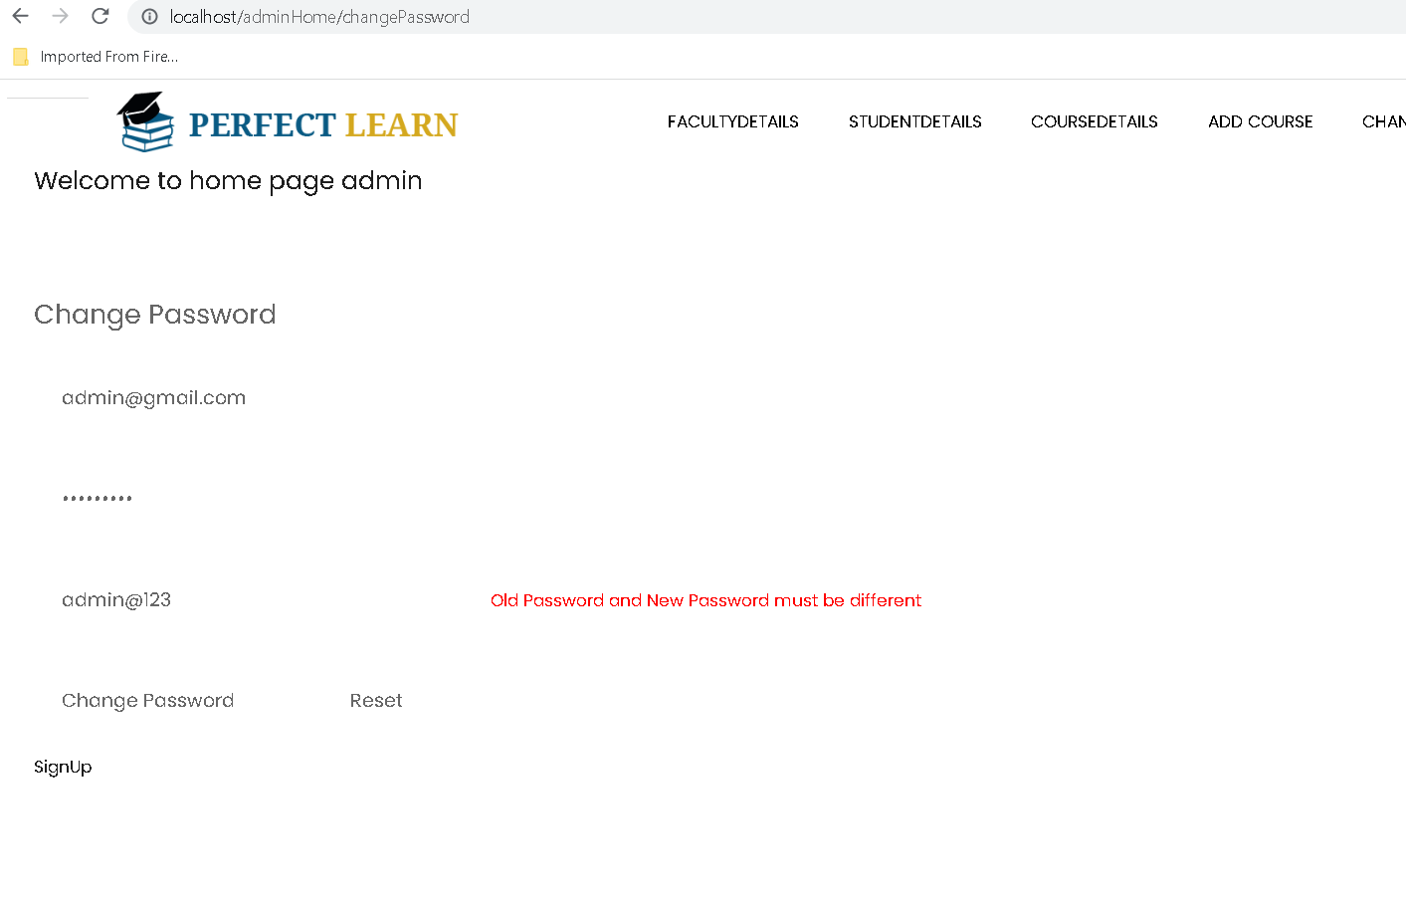
Change password

Slide 40
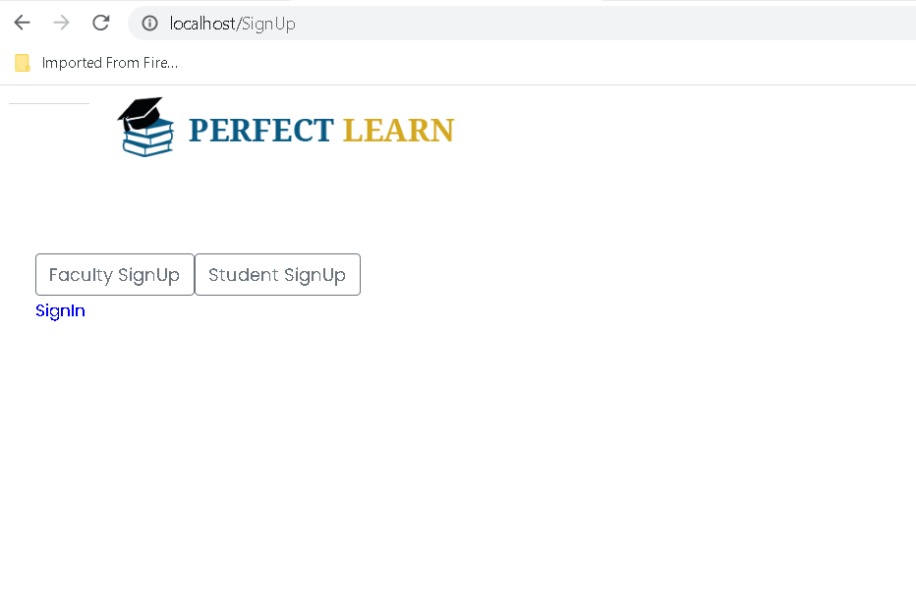
Now we will create faculty account

Slide 41
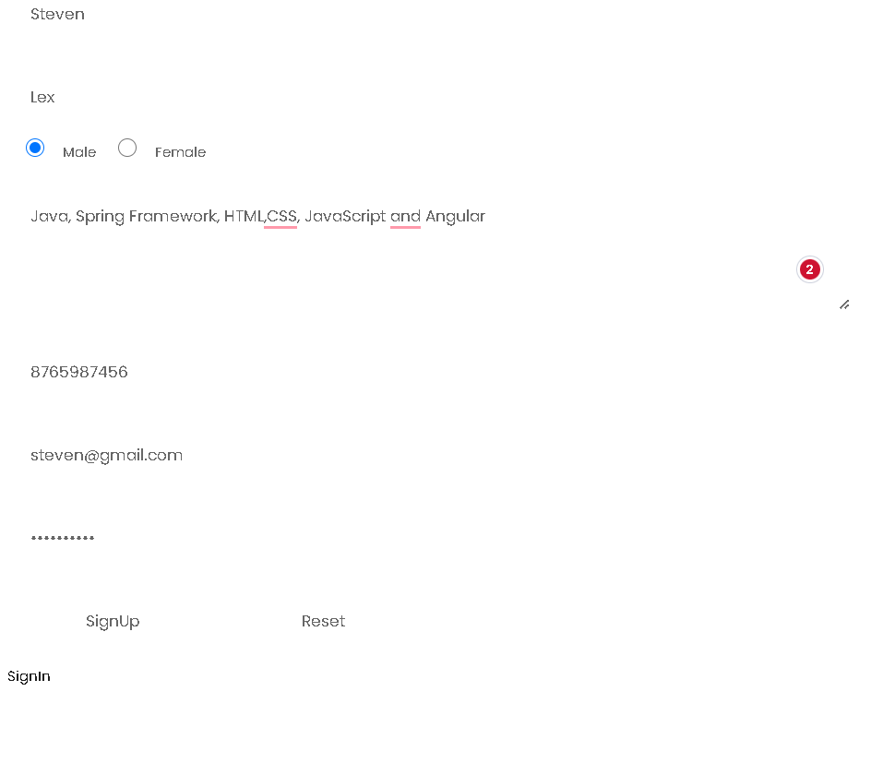
Signup for faculty account

Slide 42
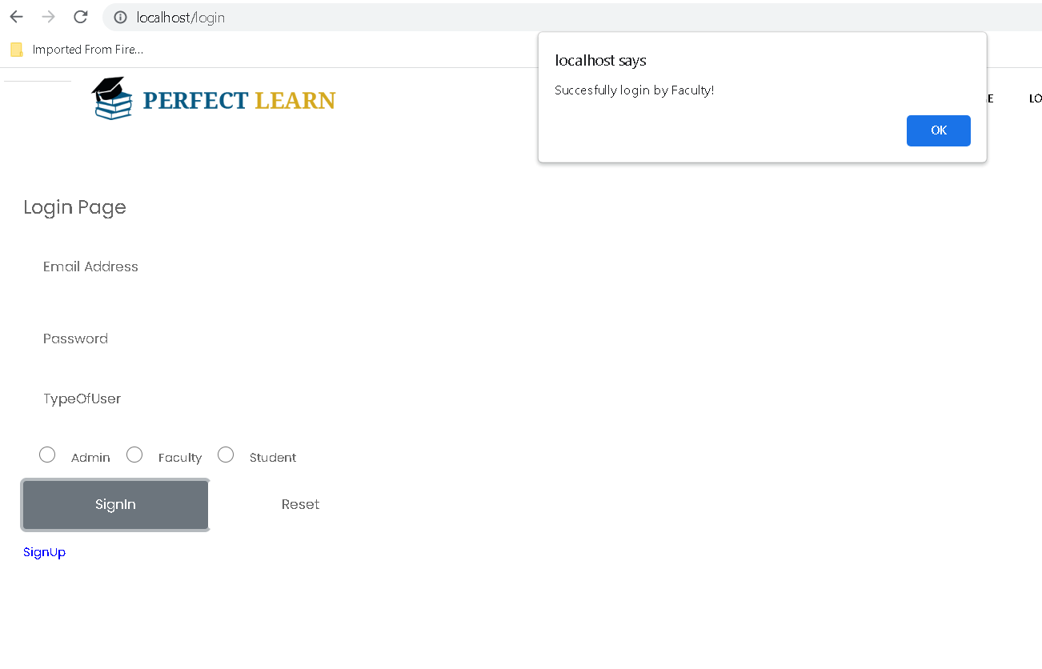
Faculty home page

Slide 43
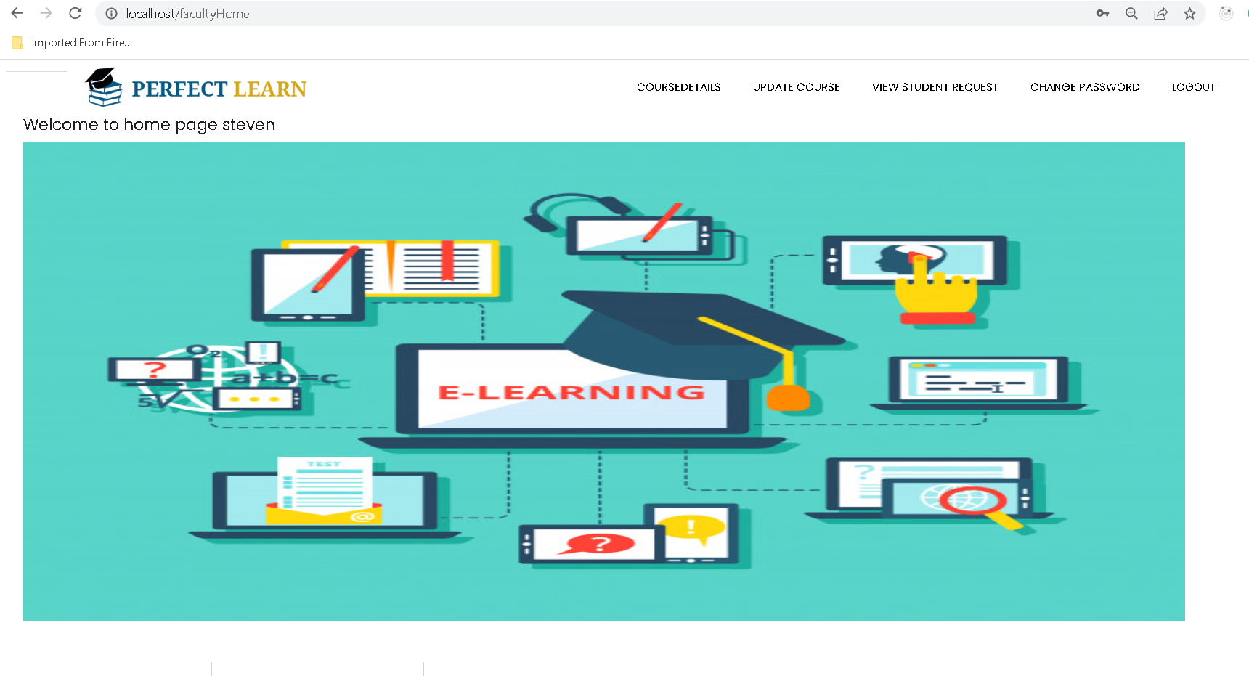
Faculty home page

Slide 44
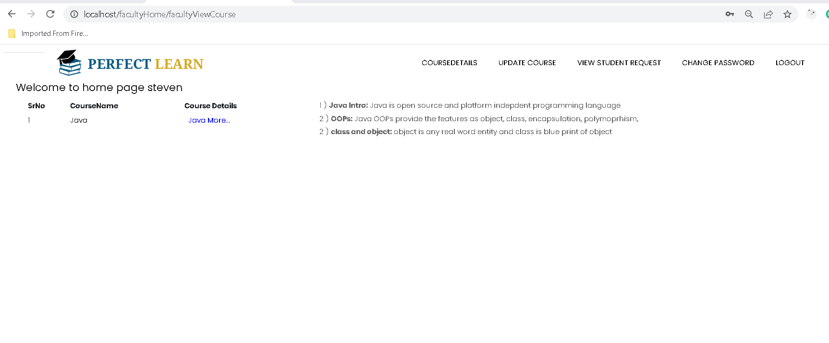
Course details

Slide 45
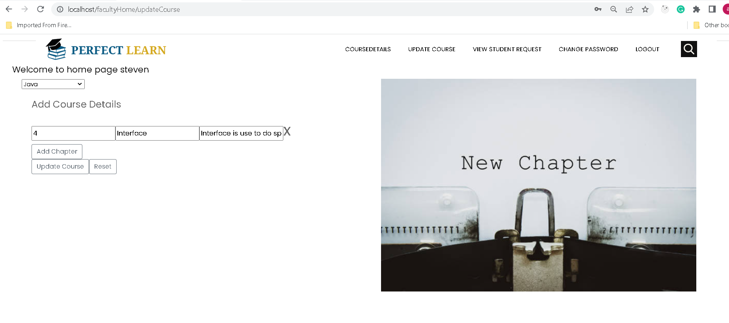
Update course

Slide 46
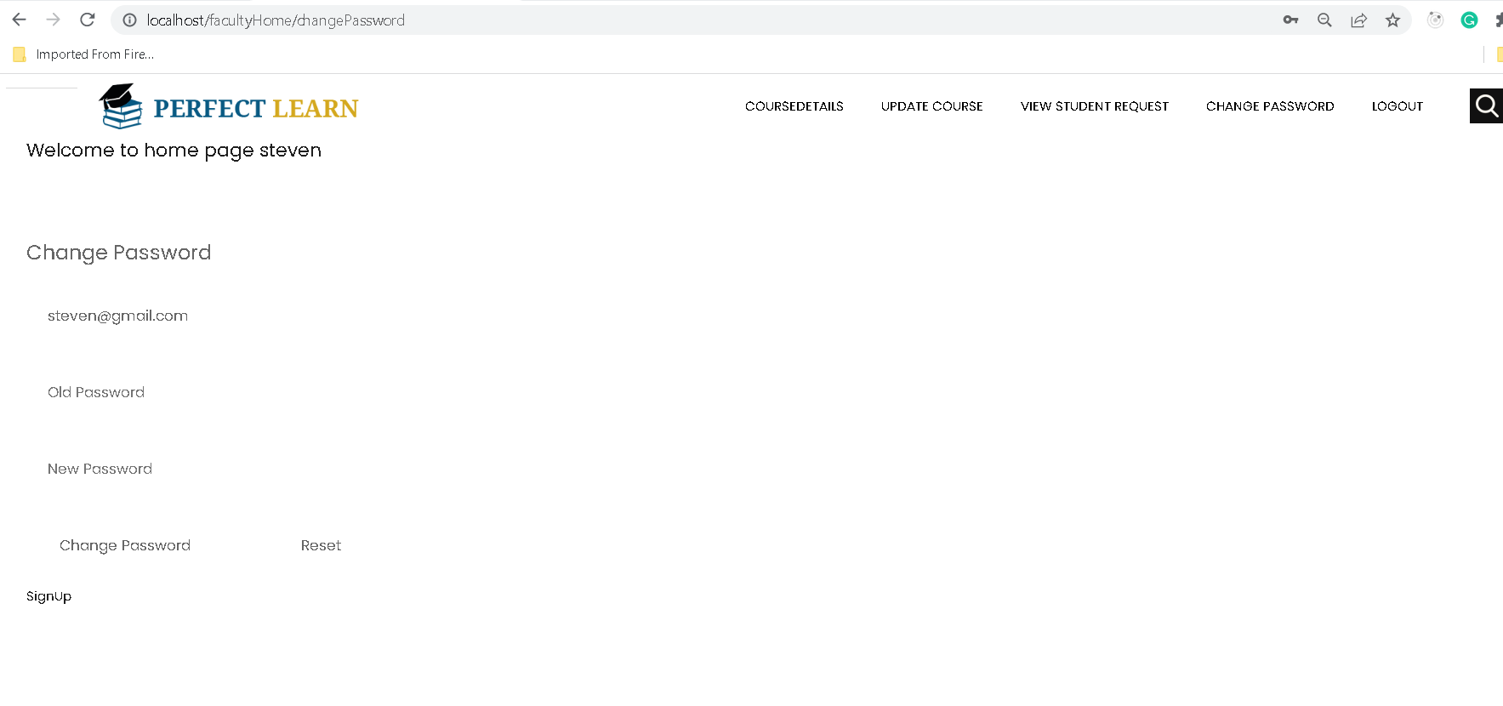
Faculty can change password

Slide 47
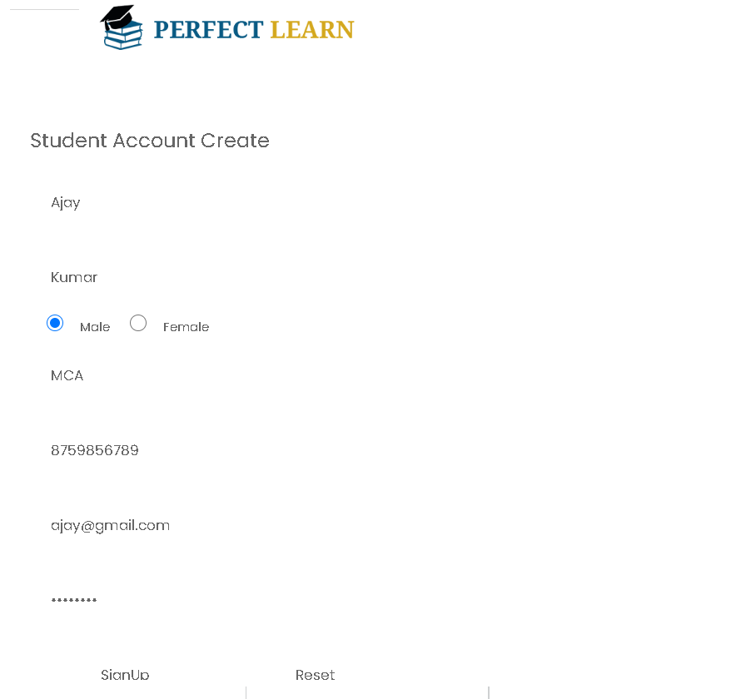
Student signup

Slide 48
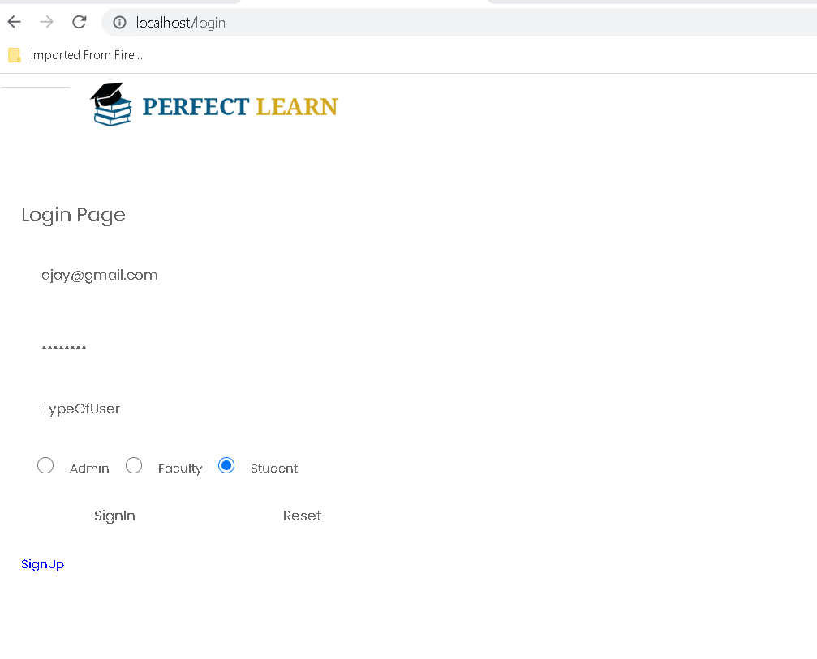
Student login

Slide 49
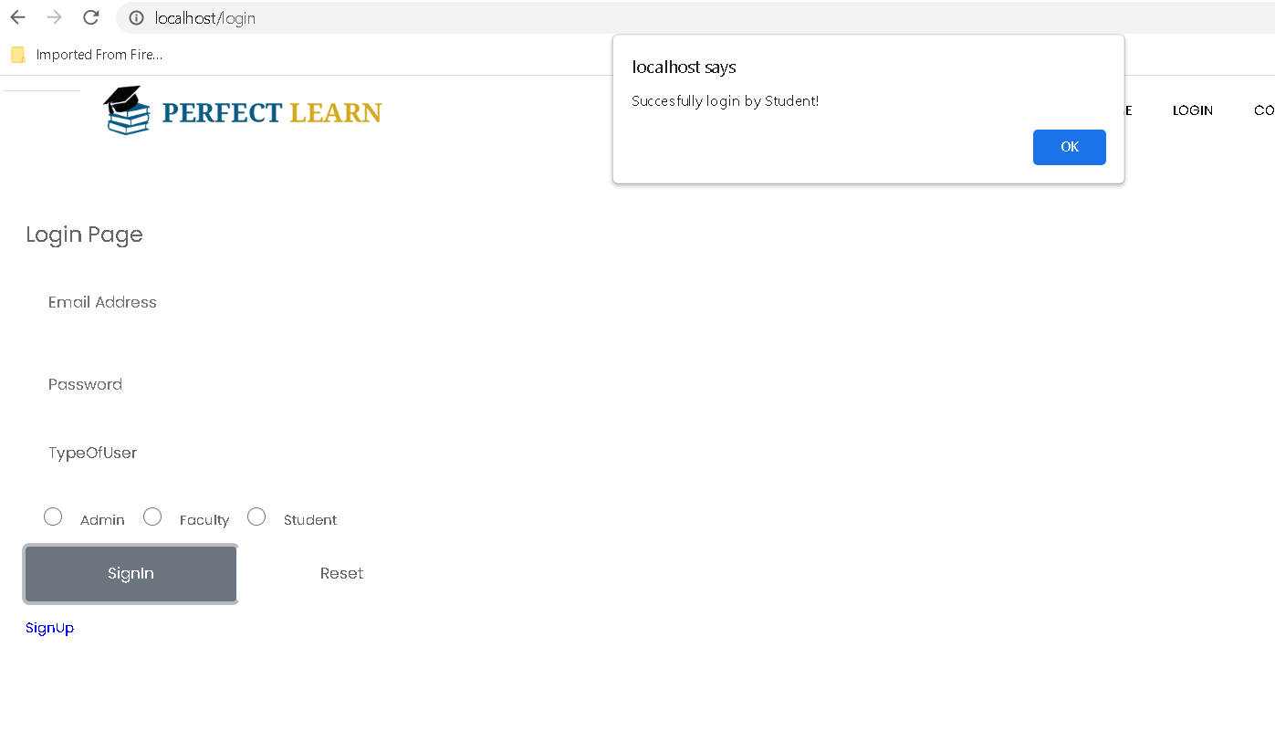
Student login successfully

Slide 50
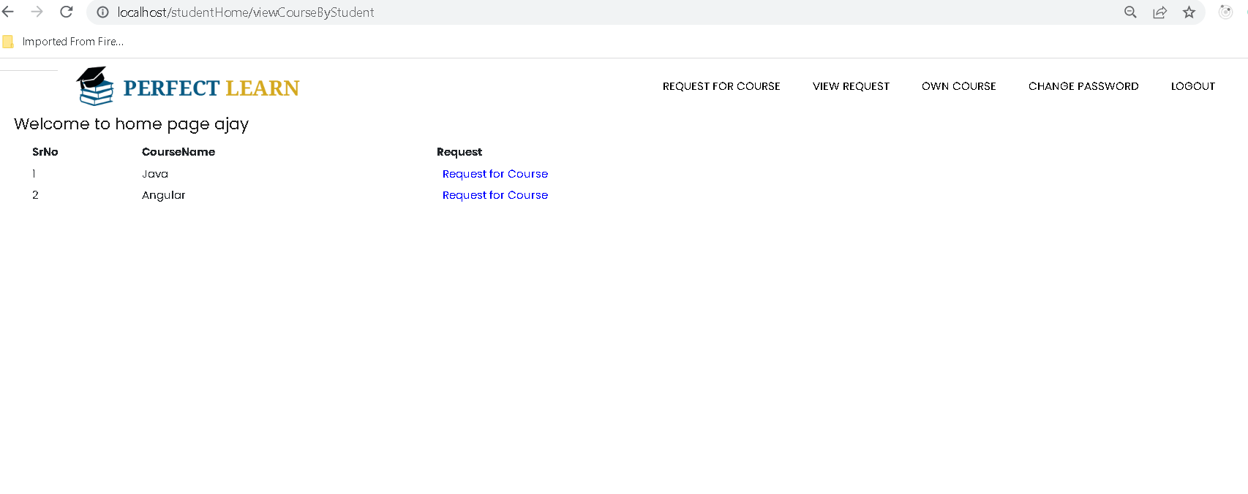
Student request for course

Slide 51
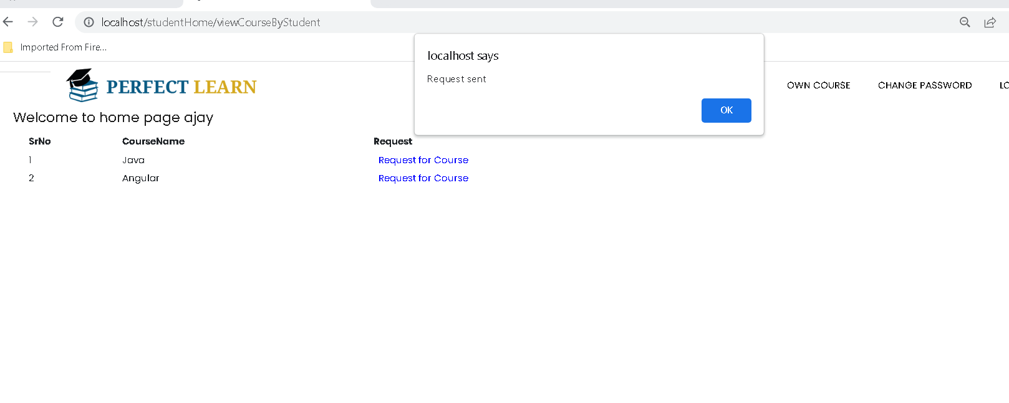
Student request sent

Slide 52
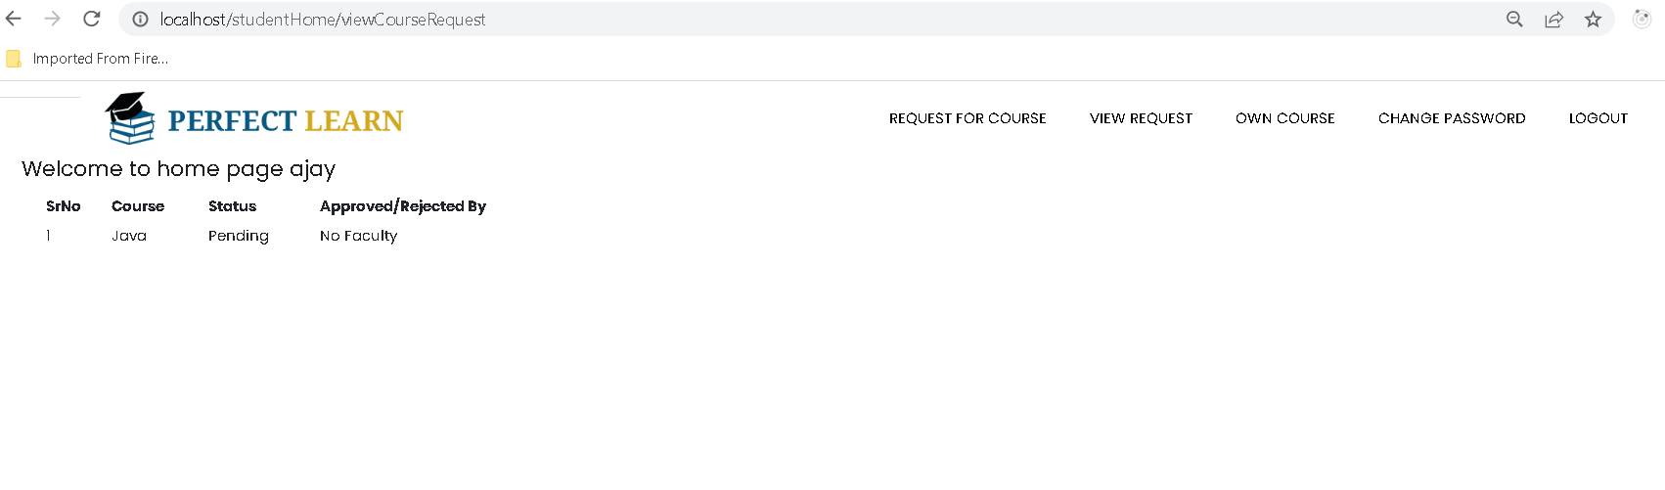
Request status sent by student

Slide 53
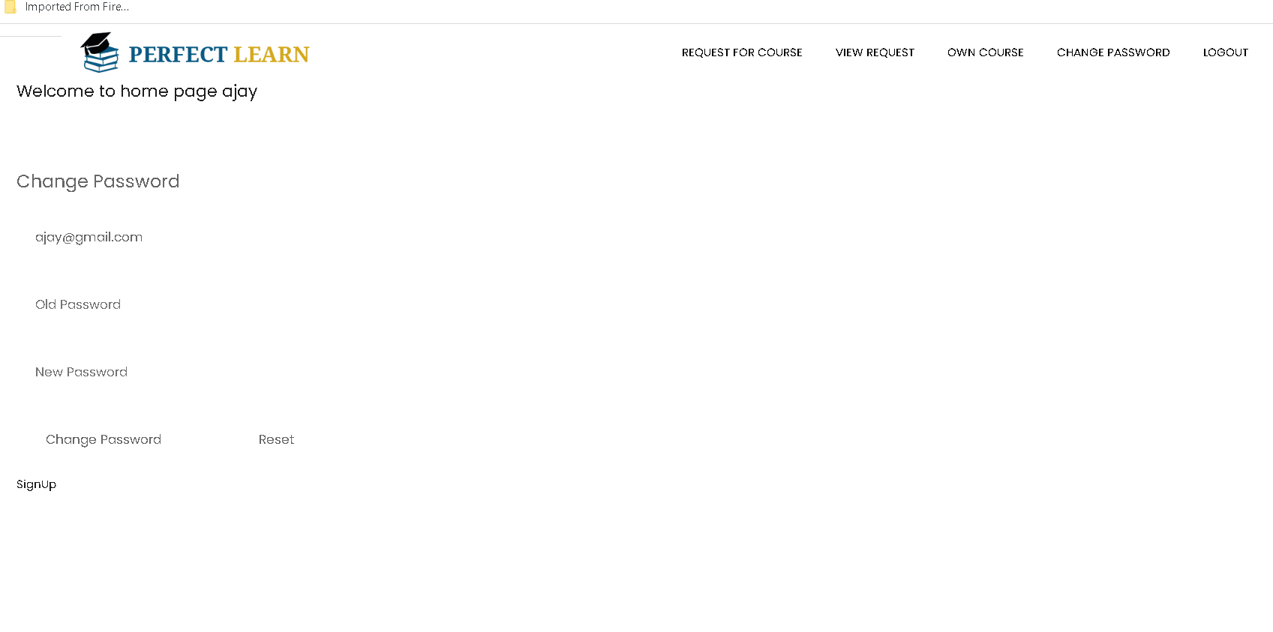
Student change password

Slide 54
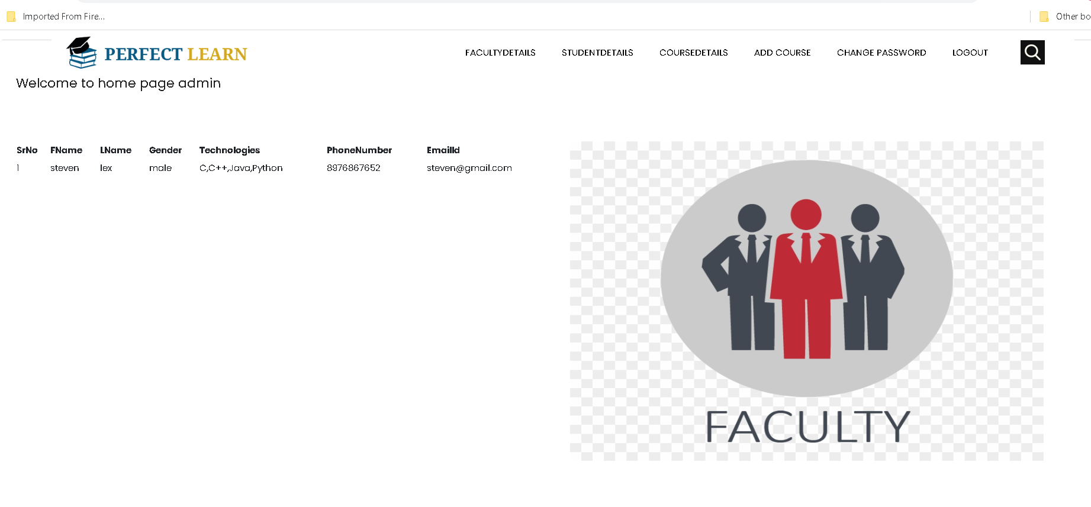
Admin can view all faculty details

Slide 55
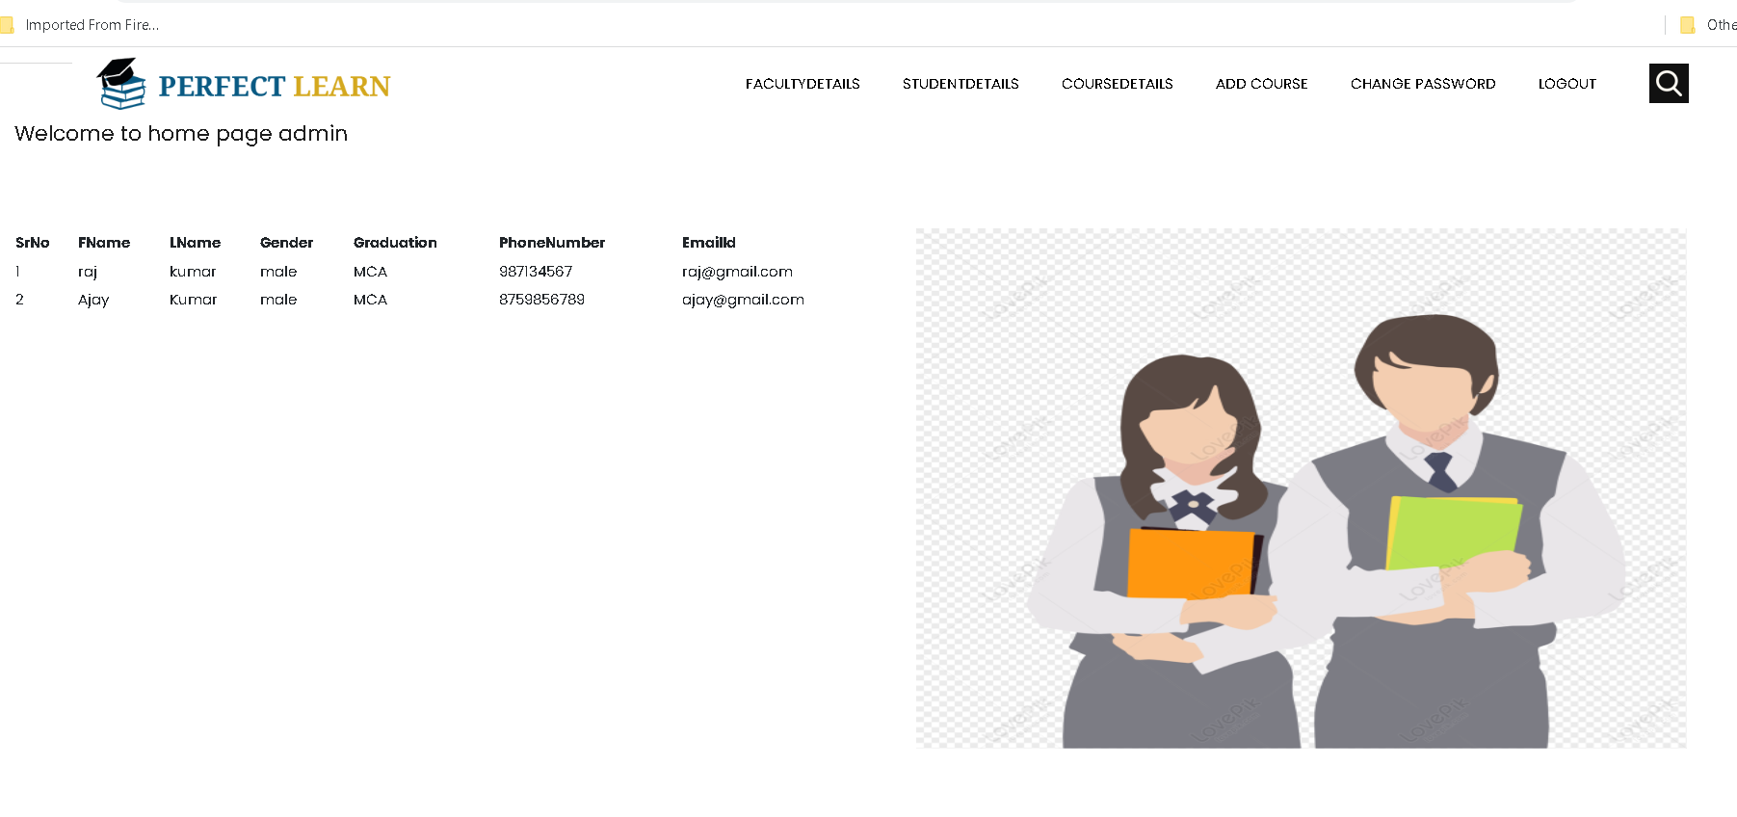
Admin can view all student details

Slide 56
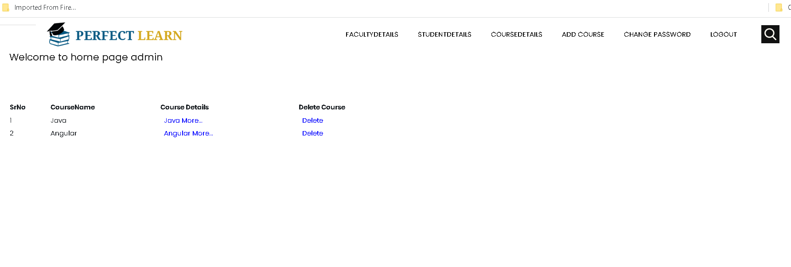
Admin can view all course details

Slide 57

Faculty can view student request

Slide 58

Faculty can approve or reject

Slide 59

After approved student can view status

Slide 60

Student can view the course

